Slide 1
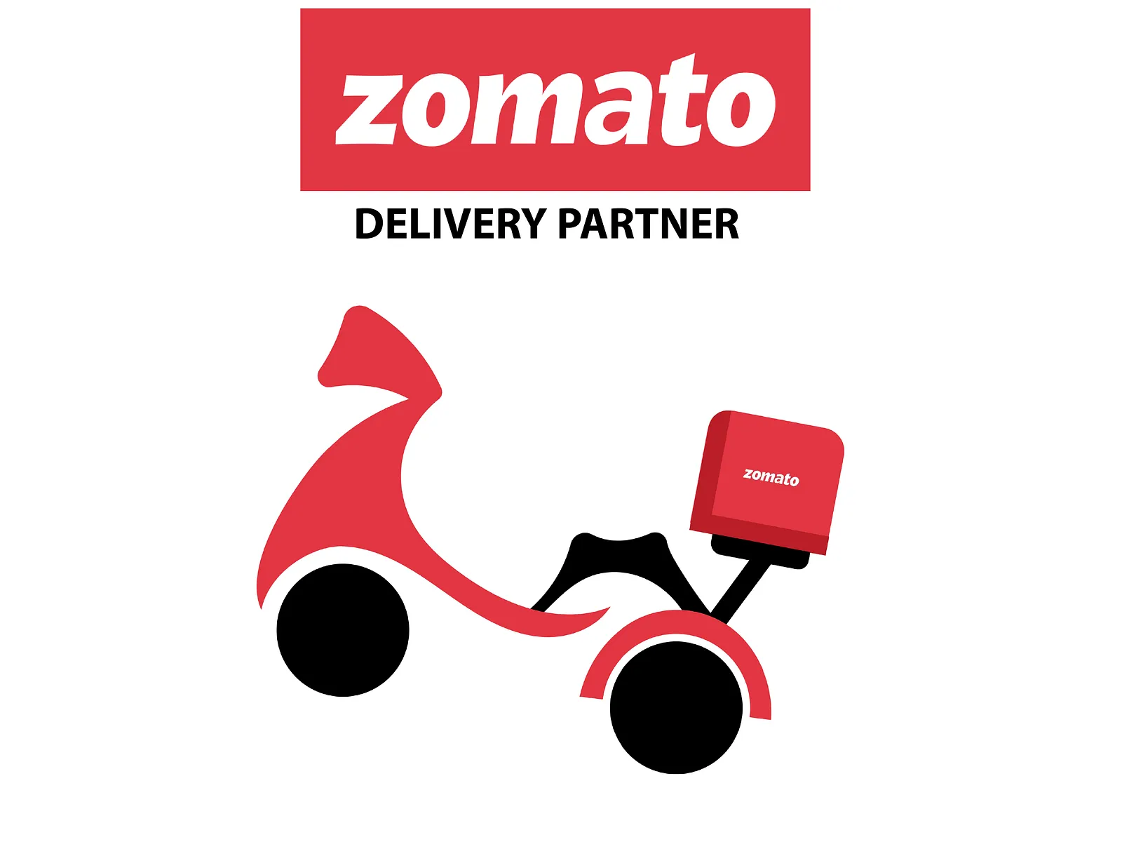
ZOMATO ANALYTICS PROJECT
Presented by – Group-1
Shreyas Reddy D
Debobrata Mukherjee
Abhijth M V
Atluri Shiva Ram
Ratnesh Ranjan Jha
Ajinkya Kailas Jadhav
Naveen Kumar Kota
Krish Bhavesh Shah

Slide 2
Project Overview & Objectives
Problem Statement: Analyzing Zomato’s global restaurant footprint to understand market trends, customer behavior, and service performance
Key Objectives:
Perform multi-country restaurant data analysis.
Evaluate the impact of Online Delivery and Table Booking on ratings.
Identify top-performing cuisines and geographical clusters.
Develop interactive cross-platform dashboards for executive decision-making

Slide 3
DATA SET AND TOOLS
Data Source: Zomato restaurant dataset
Key Columns:
Restaurant Name
City / Location
Cuisine Type
Cost for Two
Ratings
Votes
Online Delivery & Table Booking
Data Size: ~9,000+ records
Tool Used : Excel , MySQL , Tableau , Power BI , Python.

Slide 4
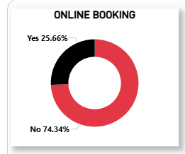
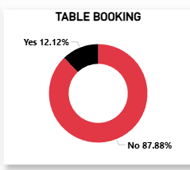
KPIs and Their Observations
Online Booking and Table Booking
Online Booking adoption is low, with only 25.66% of restaurants offering online booking, while 74.34% do not support this feature.
Table Booking availability is even lower, with just 12.12% of restaurants providing table booking options, whereas 87.88% do not offer it.
This indicates that most restaurants still rely on walk-ins or offline booking methods.
The data highlights a significant opportunity for digital transformation in the restaurant industry.
Increasing online and table booking facilities can help restaurants improve customer convenience, manage demand better, and increase operational efficiency.
1
2
3
4
5
6
7
8

Slide 5
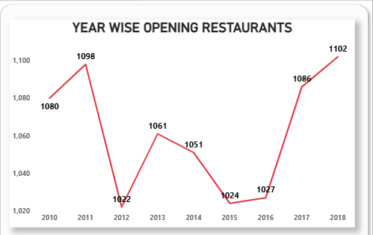
KPIs and Their Observations
Year-wise Restaurant Openings
Restaurant openings show fluctuating growth over the years.
A sharp decline is observed around 2012–2015.
From 2016 onwards, the number of new restaurants increased steadily, peaking in 2018.
1
2
3
4
5
6
7
8

Slide 6
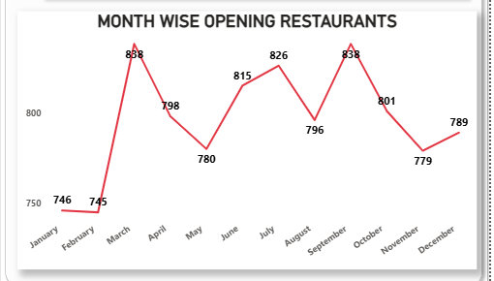
KPIs and Their Observations
Month-wise Restaurant Openings
Restaurant openings show seasonal variation across months.
March and September record the highest number of openings.
Lower openings are observed during January, February, and November.
1
2
3
4
5
6
7
8

Slide 7
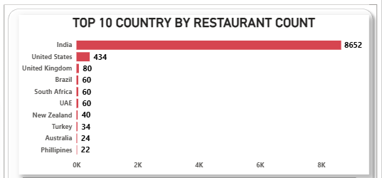
KPIs and Their Observations
Top 10 Countries by Restaurant Count
India dominates the dataset with 8,652 restaurants, far ahead of other countries.
The United States ranks second with 434 restaurants.
Other countries contribute relatively small numbers, showing limited global distribution.
1
2
3
4
5
6
7
8

Slide 8
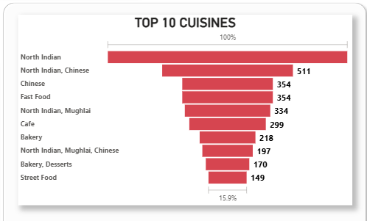
KPIs and Their Observations
Top 10 Cuisines
North Indian cuisine is the most popular, leading the list by a wide margin.
Chinese and Fast Food are also highly preferred cuisines.
Multi-cuisine combinations show strong demand, reflecting diverse customer tastes.
1
2
3
4
5
6
7
8

Slide 9
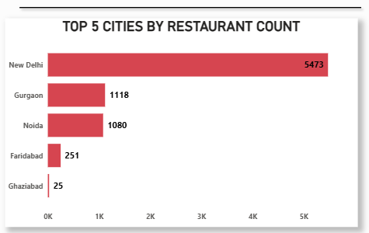
KPIs and Their Observations
Top 5 Cities by Restaurant Count
New Delhi dominates with 5,473 restaurants, far higher than other cities.
Gurgaon and Noida follow with similar restaurant counts.
Other cities contribute significantly fewer restaurants, showing high market concentration.
1
2
3
4
5
6
7
8

Slide 10
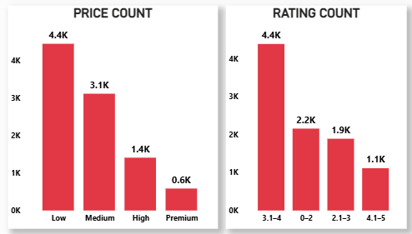
KPIs and Their Observations
Price Range & Rating Distribution
Most restaurants fall under the Low and Medium price ranges, indicating strong preference for affordability.
High and Premium price categories have significantly fewer restaurants.
Majority of restaurants have ratings between 3.1–4, showing average to good customer satisfaction.
1
2
3
4
5
6
7
8

Slide 11






KPIs and Their Observations
9,551
Total Restaurants
141
Cities Covered
2.9
Average Rating
9542
Total Cuisines
15
Countries Covered
1012
Total Votes
1
2
3
4
5
6
7
8

Slide 12




Excel
MySQL
Tableau
PowerBI

Slide 13

Excel
MySQL
Tableau
PowerBI

Slide 14
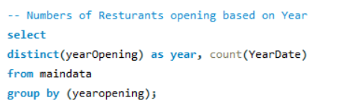
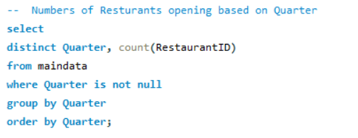
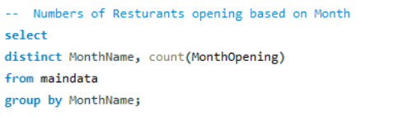
Excel
MySQL
Tableau
PowerBI

Slide 15
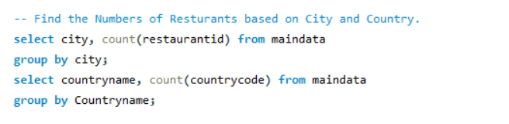
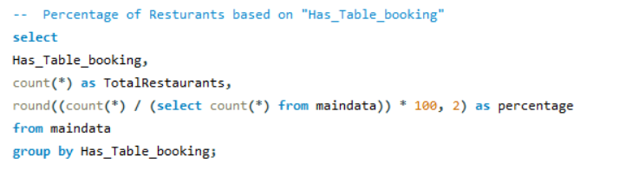
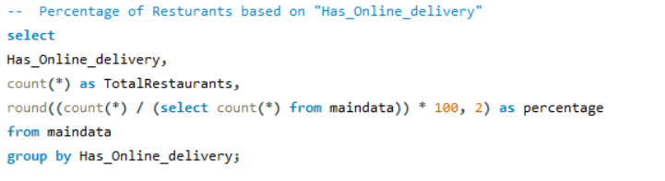
Excel
MySQL
Tableau
PowerBI

Slide 16
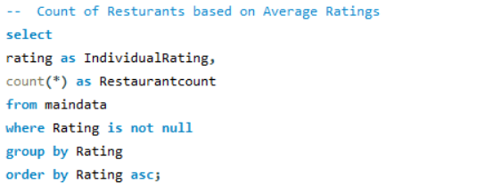
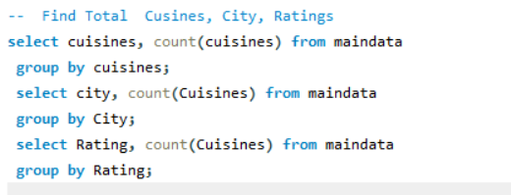
Excel
MySQL
Tableau
PowerBI

Slide 17
Excel
MySQL
Tableau
PowerBI

Slide 18
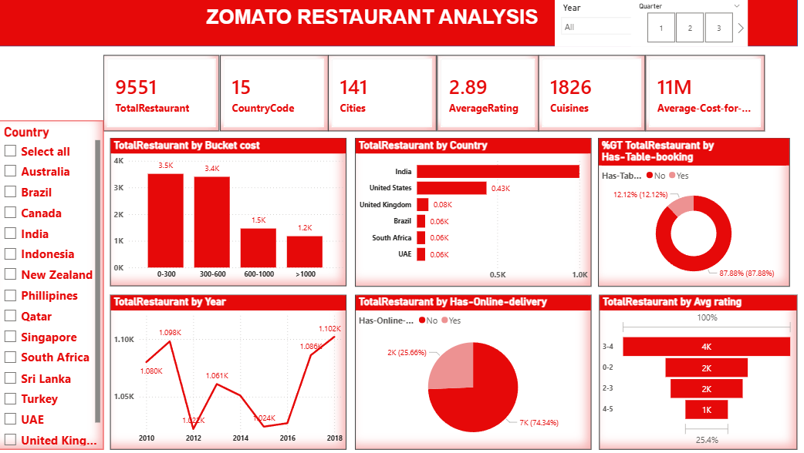
Excel
MySQL
Tableau
PowerBI

Slide 20
Challenges and How They Were Overcome
Challenges Faced
The dataset contained unstructured and inconsistent date formats, making time-based analysis difficult.
Several fields had categorical values stored as text, which required standardization before analysis.
Missing cuisine information was present for multiple restaurants, impacting cuisine-level insights.
While working with large datasets, SQL query performance issues were encountered during complex aggregations.
How the Challenges Were Overcome
Datetime conversion techniques were applied to standardize date formats and enable accurate time-based analysis.
Binary encoding was used to convert categorical Yes/No values into numeric (1/0) format for better analysis.
Data imputation methods were implemented to handle missing cuisine and other critical values.
Query optimization techniques, including the use of indexes and views, were applied to improve SQL performance.

Slide 21
Conclusion
Higher price-range restaurants tend to receive better ratings, indicating a strong link between pricing and perceived quality.
City-wise and cuisine-wise analysis supports strategic expansion decisions by identifying high-potential markets and customer preferences.
The analysis highlights strong market dominance in India, with a clear preference for affordable pricing and local cuisines.
Low adoption of online delivery and table booking in certain regions presents opportunities for growth.
Seasonal trends in restaurant openings indicate time-based expansion and marketing opportunities.

Slide 22
Conclusion
Future Roadmap & Recommendations
Digitization Push: Aggressively onboard the 75% of restaurants currently not offering Online Delivery.
Quality Improvement: Targeted consulting for restaurants in the 2.0–3.0 rating range to push them into the "Excellent" (4+) category.
Tier-2 City Focus: New Delhi is saturated; expansion should focus on high-growth cities like Ahmedabad and Bangalore where ratings are trending upward.

Slide 23
THANK YOU

